Slide 1


From Brainwaves to Awakening
Alpha Waves and Higher States of Consciousness
“Educational content – not medical or commercial advice”
© 2026 Jos Daniel · All rights reserved.

Slide 2

Why This Topic Matters
Human experience ranges from stress and overthinking to deep peace and insight
Modern tools let us measure brain rhythms behind these states
Ancient traditions describe states like Samadhi and Satori
This presentation looks at where these perspectives meet
© 2026 Jos Daniel · All rights reserved.

Slide 3
What We Will Explore
Brainwave basics: delta, theta, alpha, beta, gamma
Why alpha waves are linked to relaxed, aware states
How meditation shifts brain activity
What do traditions mean by Samadhi and Satori
How modern techniques like neurofeedback try to support these states
The deeper biological complexity: lobes, thalamus, & brain cell types
Sound as cognitive load, and frontier science with the labels left on
© 2026 Jos Daniel · All rights reserved.

Slide 4
SECTION 2 – BRAINWAVE BASICS
© 2026 Jos Daniel · All rights reserved.

Slide 5
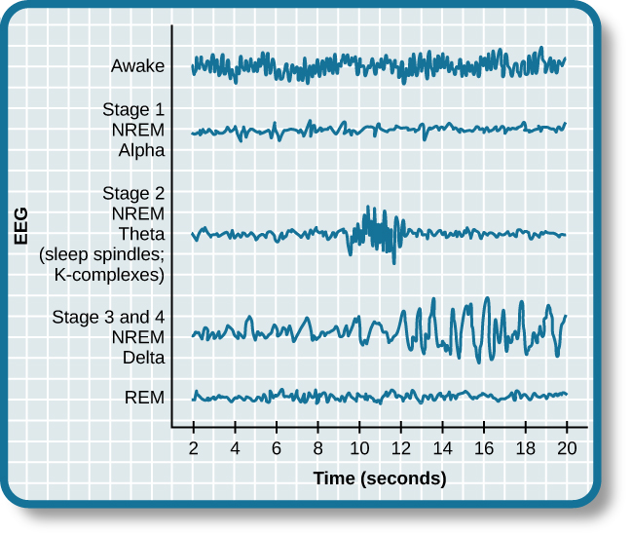
Brainwaves: The Brain’s Rhythms
Nerve cells fire in rhythmic patterns that can be recorded as brainwaves
Measured using electroencephalography (EEG)
Frequencies are grouped into bands that correlate with different mental states
© 2026 Jos Daniel · All rights reserved.

Slide 6
The Main Brainwave Bands
Delta (0.5–4 Hz): deep sleep, unconscious processes
Theta (4–7 Hz): drowsiness, light sleep, imagery, some meditative states
Alpha (8–12 Hz): relaxed, awake, eyes closed, calm focus
Beta (13–30 Hz): active thinking, focus, problem solving
Gamma (30+ Hz): complex integration, high-level cognitive processing
© 2026 Jos Daniel · All rights reserved.

Slide 7
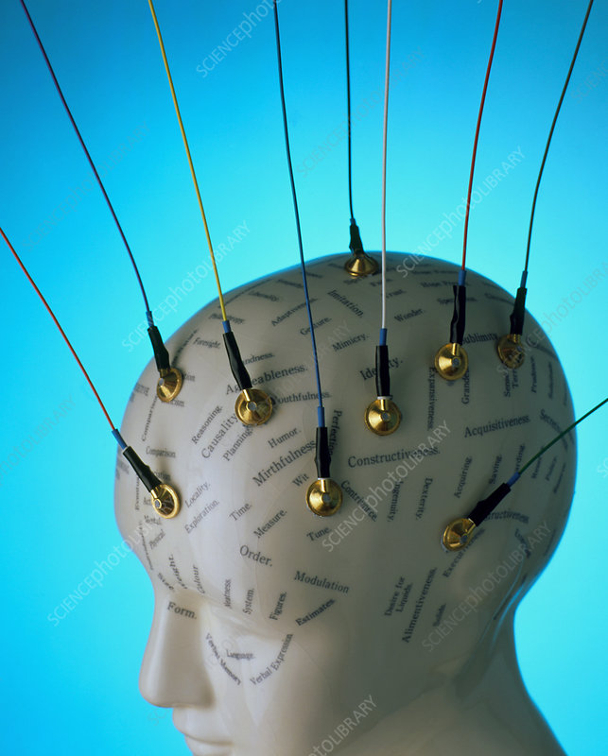
How EEG Sees These Signals
Electrodes on the scalp measure tiny voltage changes
Signals are amplified and filtered into frequency bands
Patterns change with:
  Eyes open vs closed
  Relaxation vs stress
  Meditation vs ordinary thinking
© 2026 Jos Daniel · All rights reserved.

Slide 8
Brainwaves Are Patterns, Not Boxes
All bands are usually present at the same time
What changes is which pattern dominates
States like “relaxed but alert” show more alpha; “high effort thinking” shows more beta
Meditation often shifts the balance toward alpha and theta
© 2026 Jos Daniel · All rights reserved.

Slide 9
SECTION 3 – DEEP DIVE ON ALPHA WAVES
© 2026 Jos Daniel · All rights reserved.

Slide 10

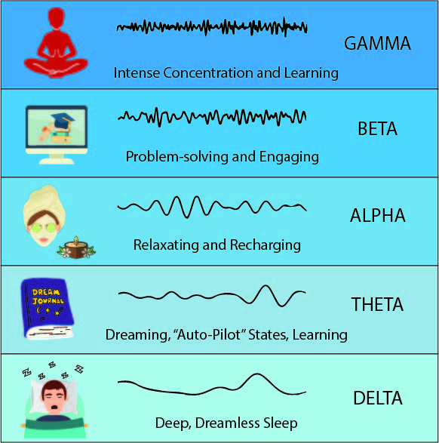
What Are Alpha Waves?
Frequency range: 8–12 Hz
Common when:
  Eyes are closed
  Body is relaxed
  Mind is calm but awake
Often strongest over the occipital and parietal regions in resting wakefulness
© 2026 Jos Daniel · All rights reserved.

Slide 11

Alpha and the Relaxed–Alert State
Alpha appears when we are:
  Not actively problem-solving
  Not fully asleep
Associated with:
  Calm awareness
  Internal focus
  Sense of ease and spaciousness
© 2026 Jos Daniel · All rights reserved.

Slide 12

High Alpha and Creativity
Studies link higher alpha power to:
  Enhanced creativity and idea generation
  Better integration of internal and external information
Many people report “zones” of insight or flow when alpha increases
© 2026 Jos Daniel · All rights reserved.

Slide 13

Alpha, Stress and Emotional Balance
When stress rises, beta activity tends to dominate
Practices that increase alpha may:
  Reduce perceived stress
  Support emotional regulation
  Improve sense of well-being
This is one reason alpha is a key focus in meditation research
© 2026 Jos Daniel · All rights reserved.

Slide 14

Alpha as a Gateway State
Alpha can be seen as a bridge between everyday thinking and deeper states
From here, some meditators move into:
  Theta-dominant imagery and intuition
  Stillness and non-dual awareness
This “alpha bridge” concept connects modern data with traditional descriptions of Samadhi
© 2026 Jos Daniel · All rights reserved.

Slide 15
Thalamic Pacemaker Neurons
Thalamus and the Origin of Alpha Rhythms
The thalamus is a deep brain structure that relays sensory and motor information to the cortex.
Certain thalamic neurons behave as “pacemaker cells,” capable of generating rhythmic electrical activity.
These neurons naturally oscillate within the alpha frequency range (8–12 Hz).
Alpha rhythms can persist even when thalamic neurons are isolated from other brain networks.
© 2026 Jos Daniel · All rights reserved.

Slide 16
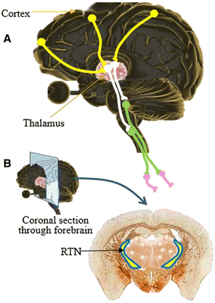
Thalamo-Cortical Alpha Loop
Pacemaker neurons in the thalamus connect to the cortex via thalamo-cortical fibers.
The cortex sends feedback to the thalamus, forming a continuous neural loop.
This loop supports not only alpha rhythms, but most large-scale EEG oscillations.
EEG alpha waves represent the surface expression of this deeper rhythmic circuit.
© 2026 Jos Daniel · All rights reserved.

Slide 17
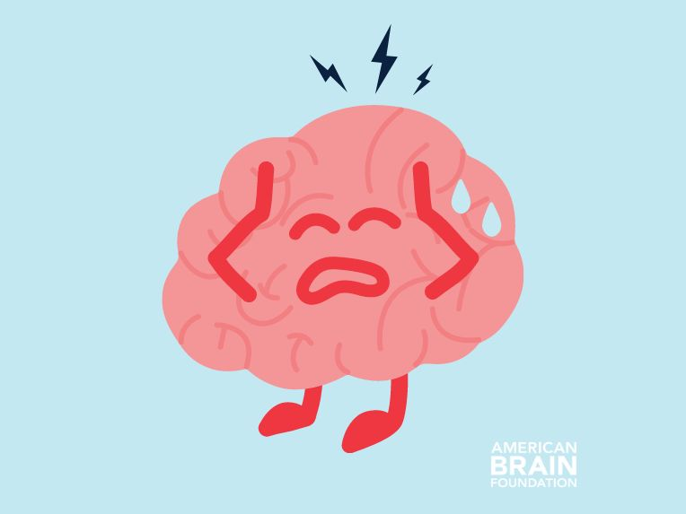
Stress, Ego & Alpha Disruption
Psychological Stress and Alpha Suppression
Persistent life stress activates sympathetic nervous system circuits and increases beta-dominant cortical activity.
Rumination and ego-based emotional reactions maintain high cognitive arousal.
This reduces thalamo-cortical synchronization, suppressing sustained alpha dominance.
Result:
  Less calm awareness
  More mental noise
  Reduced meditative depth
© 2026 Jos Daniel · All rights reserved.

Slide 18
SECTION 4 – MEDITATION & BRAINWAVES
© 2026 Jos Daniel · All rights reserved.

Slide 19
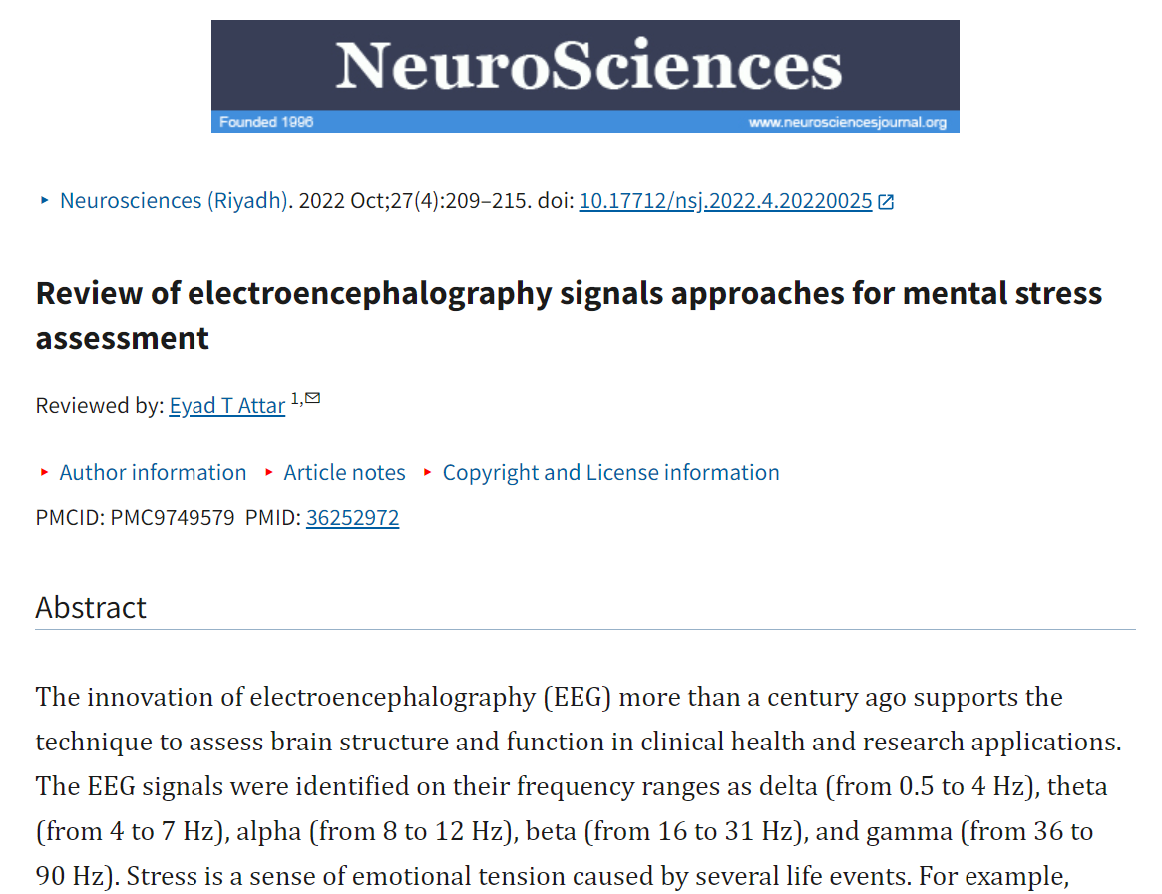
What Meditation Does to Brainwaves (Big Picture)
Different meditation styles show different EEG patterns
Common trends include:
  Increased alpha and theta during relaxation and focused attention
  Sometimes increased gamma in advanced practitioners
These shifts reflect changes in attention, self-focus, and sensory processing
© 2026 Jos Daniel · All rights reserved.

Slide 20

From Discursive Thought to Quiet Awareness
Ordinary mind: fast, fragmented, beta-dominant patterns
As the mind settles:
  Inner talk reduces
  Alpha and theta grow stronger
Subjectively experienced as:
  Less chatter
  More presence
  Expanded, quiet awareness
© 2026 Jos Daniel · All rights reserved.

Slide 21

Long-Term Meditators and Alpha Activity
Long-term meditators often show:
  More stable alpha rhythms at rest
  Easier transition into alpha/theta dominance when meditating
Traditional language: “mind drops into meditation more quickly.”
© 2026 Jos Daniel · All rights reserved.

Slide 22
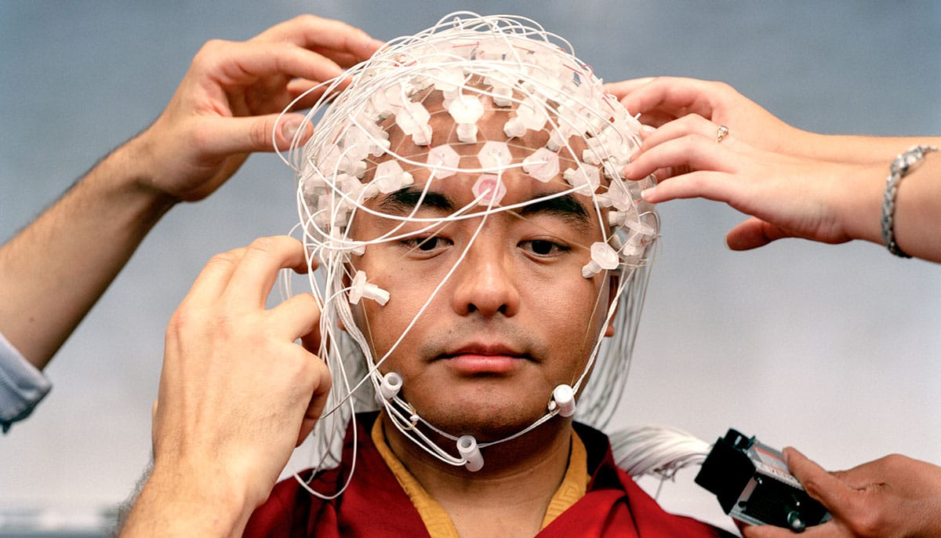
Subjective Experience vs Objective Signals
EEG records electrical patterns, not “enlightenment”
Correlations:
  Calm, open awareness ↔ stronger alpha
  Drowsy imagery ↔ more theta
Inner experiences (peace, insight, non-duality) cannot be reduced to one frequency band
© 2026 Jos Daniel · All rights reserved.

Slide 23

Respecting Both Lenses
Neuroscience lens: brainwaves, networks, connectivity
Contemplative lens: mind, awareness, insight, compassion
The goal is not to force them into one system, but to let them illuminate each other
© 2026 Jos Daniel · All rights reserved.

Slide 24
SECTION 5 – SAMADHI IN THE YOGIC TRADITION
© 2026 Jos Daniel · All rights reserved.

Slide 25

Samadhi: The Eighth Limb of Yoga
In Patanjali’s Ashtanga Yoga, Samadhi is the eighth and final limb
It is described as meditative absorption where:
  The meditator
  The object of meditation
  And the process of meditating becomes one
© 2026 Jos Daniel · All rights reserved.

Slide 26

How Samadhi Is Described
Deep state of meditation; fluctuations of mind become quiet
Sense of separate “I” softens or disappears
Awareness is steady, luminous, and undistracted
Often linked with experiences of unity or oneness
© 2026 Jos Daniel · All rights reserved.

Slide 27

Stages or Types of Samadhi (High Level)
Some traditions distinguish:
  Samadhi with support (object of meditation still present)
  Samadhi without support (pure awareness beyond specific objects)
These are described qualitatively, not in terms of EEG alone
© 2026 Jos Daniel · All rights reserved.

Slide 28
Samadhi and the Brain
Research suggests Samadhi-like states may correlate with:
  High, stable alpha and theta activity
  Changes in networks related to self-referential processing
Important: Traditional texts emphasise ethics, discipline and insight, not just brain rhythms
© 2026 Jos Daniel · All rights reserved.

Slide 29
SECTION 6 – SATORI IN ZEN BUDDHISM
© 2026 Jos Daniel · All rights reserved.

Slide 30

What Is Satori?
In Zen Buddhism, Satori means “awakening” or sudden intuitive insight
Often described as seeing into one’s true nature
Not gradual absorption, but a breakthrough moment
© 2026 Jos Daniel · All rights reserved.

Slide 31

Features of Satori Experiences
Sudden, powerful shift in perception
Sense that ordinary reality is seen in a completely new way
Often accompanied by:
  Clarity
  Freedom from habitual views
  Deep simplicity and immediacy
© 2026 Jos Daniel · All rights reserved.

Slide 32

Practice Context for Satori
Arises within disciplined practice:
  Zazen (seated meditation)
  Koan inquiry
  Daily mindfulness training
Teachers emphasise that Satori is not the final end, but a significant step
© 2026 Jos Daniel · All rights reserved.

Slide 33
Satori and Brain Activity (What We Know, What We Don’t)
A few studies have tried to record sudden insight states, but:
  Data are limited
  Experiences are hard to time and reproduce in lab settings
Hypotheses discuss rapid shifts in network connectivity and synchrony, sometimes involving alpha and gamma changes, with some studies confirming it
© 2026 Jos Daniel · All rights reserved.

Slide 34
SECTION 7 – SAMADHI VS SATORI
© 2026 Jos Daniel · All rights reserved.

Slide 35
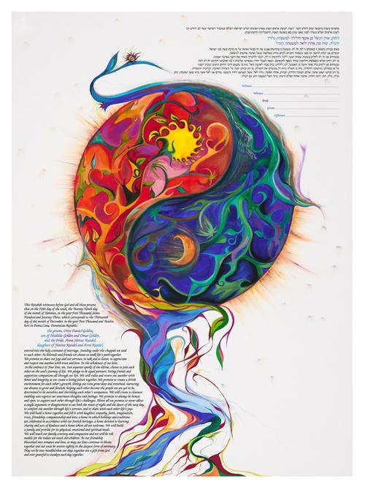
Two Words, Two Emphases
Samadhi:
  Gradual cultivation
  Stable meditative absorption
  Emphasis on continuity and depth
Satori:
  Sudden awakening
  Breakthrough insight
  Emphasis on immediacy and direct seeing
© 2026 Jos Daniel · All rights reserved.

Slide 36
Complementary Perspectives
Samadhi highlights stability of consciousness
Satori highlights sudden transformation of perception
Many practitioners describe both:
  Gradual deepening
  Punctuated by key breakthroughs
© 2026 Jos Daniel · All rights reserved.

Slide 37

How Alpha Waves Fit Into This Picture
In both routes, cultivation often involves:
  Repeated calming of discursive thought
  Strengthening of relaxed, focused awareness
Alpha waves may reflect these common processes, even if the interpretation of the resulting state differs across traditions
© 2026 Jos Daniel · All rights reserved.

Slide 38
SECTION 8 – MODERN TOOLS: NEUROFEEDBACK & BIOFEEDBACK
© 2026 Jos Daniel · All rights reserved.

Slide 39
What Is Neurofeedback?
A form of biofeedback using EEG
Real-time information about brainwave patterns is given back to the person
When desired patterns (e.g., stronger alpha) appear, the system gives a pleasant tone or visual cue
© 2026 Jos Daniel · All rights reserved.

Slide 40
How Neurofeedback Training Works (Conceptually)
Brain activity → EEG recording
Software detects target patterns (e.g., increased alpha)
Feedback:
  Tone gets louder
  Image gets brighter
The brain gradually learns to produce more of the rewarded pattern through reinforcement
© 2026 Jos Daniel · All rights reserved.

Slide 41
Alpha Training and Meditation-Like States
Intensive alpha training sessions can:
  Help participants recognise the feeling of alpha-dominant states
  Encourage relaxation and inner focus
Some programs suggest that this may accelerate access to meditation-like experiences, but results vary between individuals
© 2026 Jos Daniel · All rights reserved.

Slide 42
A Neutral Perspective on Neurofeedback
Potential benefits:
  Objective feedback for otherwise subtle inner states
  Additional tool for self-regulation and awareness training
Important considerations:
  Not a shortcut to enlightenment
  Not a replacement for ethical practice, guidance or therapeutic care
  Claims should be evaluated carefully
© 2026 Jos Daniel · All rights reserved.

Slide 43
SECTION 9 – THE BRAIN’S DEEP COMPLEXITY
© 2026 Jos Daniel · All rights reserved.

Slide 44
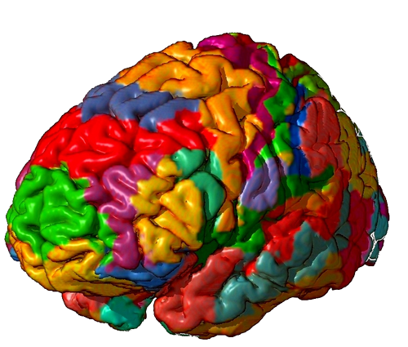
52 Brodmann Areas, Not 52 Lobes
One detailed anatomical model divides the cortex into 52 Brodmann areas — fine-grained functional regions, not literal lobes
These lobes participate in:
  Motor control
  Sensory processing
  Language
  Emotion
  Higher cognition
© 2026 Jos Daniel · All rights reserved.

Slide 45
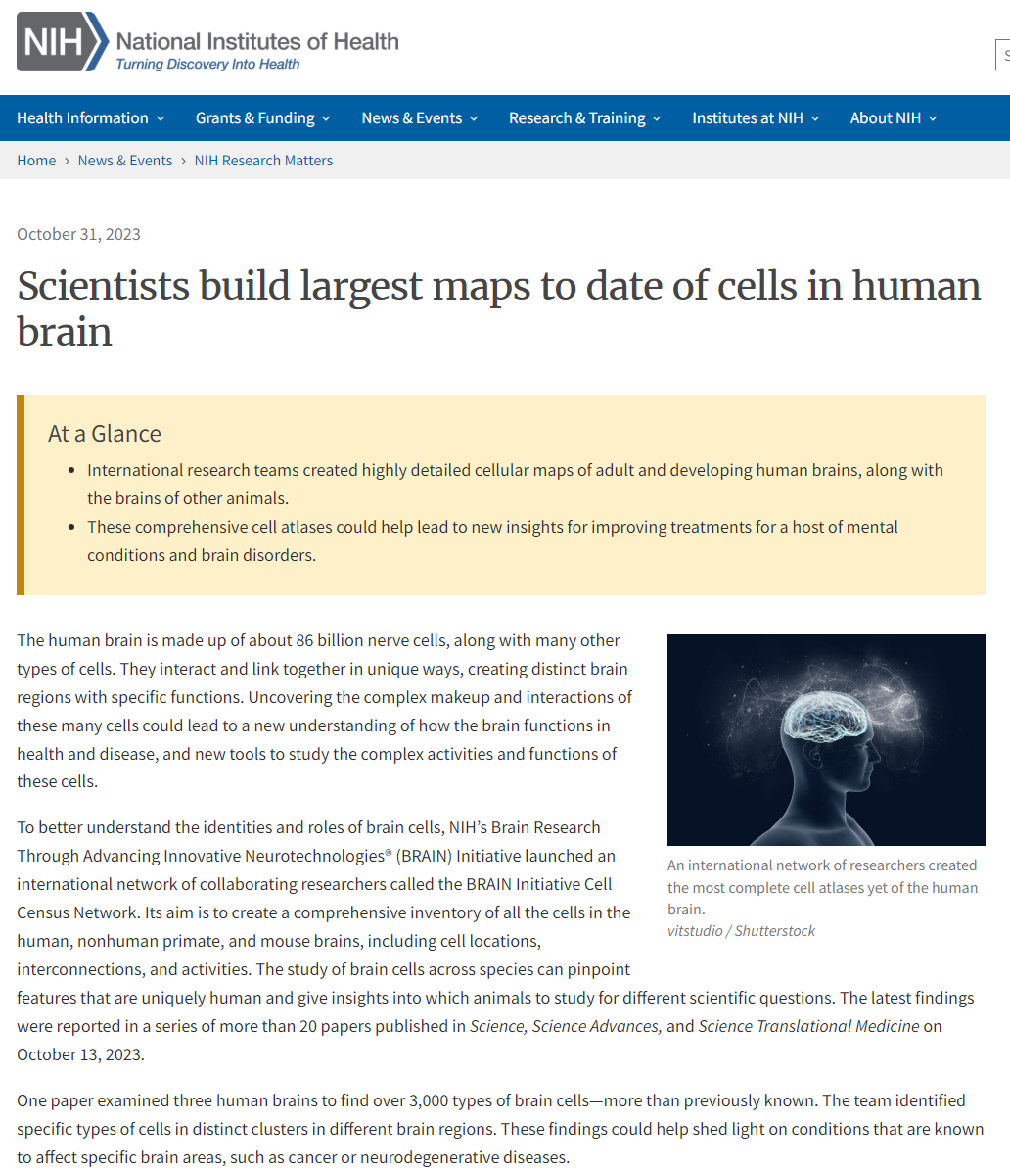

3000 Brain Cell Types and Transcription Factor Groups
Although the brain’s cells fall into two great families, neurons and glia
  Neurons
  Glial Cells
  Stem cells
However, each family branches into numerous subtypes, and researchers have identified as many as 3000 of them!
This diversity underlies learning, plasticity, and brain health
© 2026 Jos Daniel · All rights reserved.

Slide 46
Why This Complexity Matters for Meditation
When brainwaves change, they do so across this entire ecosystem
States like Samadhi or Satori are not the product of one area or one cell type
They reflect coordinated activity across many lobes and networks at once
© 2026 Jos Daniel · All rights reserved.

Slide 47
SECTION 10 – SOUND, LISTENING EFFORT & THE ATTENTION BUDGET
© 2026 Jos Daniel · All rights reserved.

Slide 48
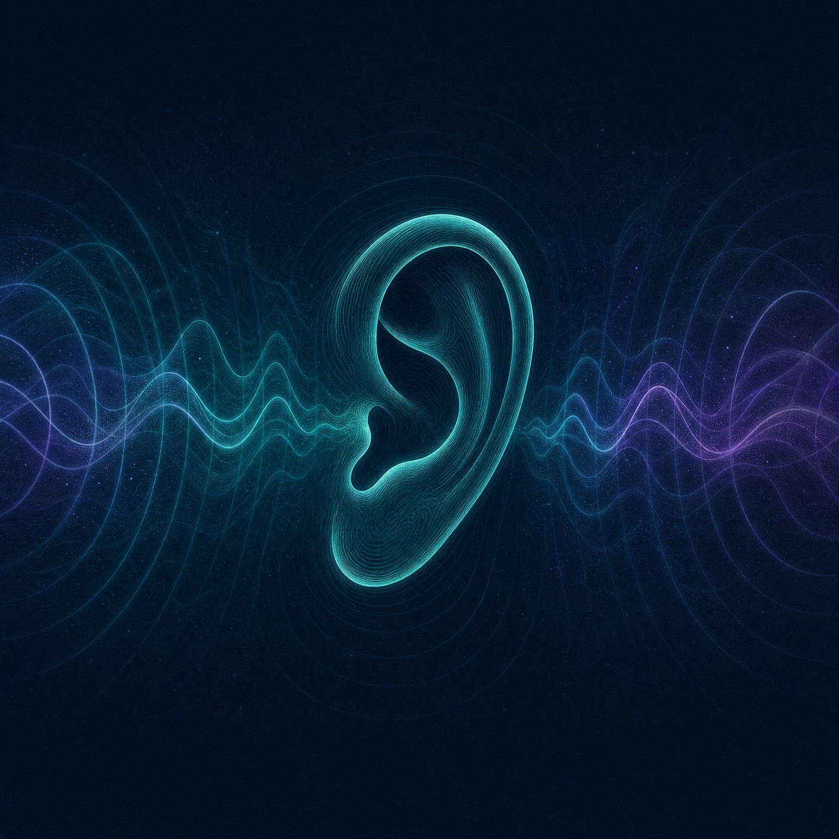
Sound: The Input Nobody Audits
We measure sleep, light, air, glucose and training — but rarely the sound we sit inside all day
The auditory system has no eyelids: processing is obligatory, and continues even during sleep
Degraded or noisy signals recruit attention involuntarily
A typical knowledge worker spends 8–12 hours daily in acoustic environments they have never evaluated
© 2026 Jos Daniel · All rights reserved.

Slide 49
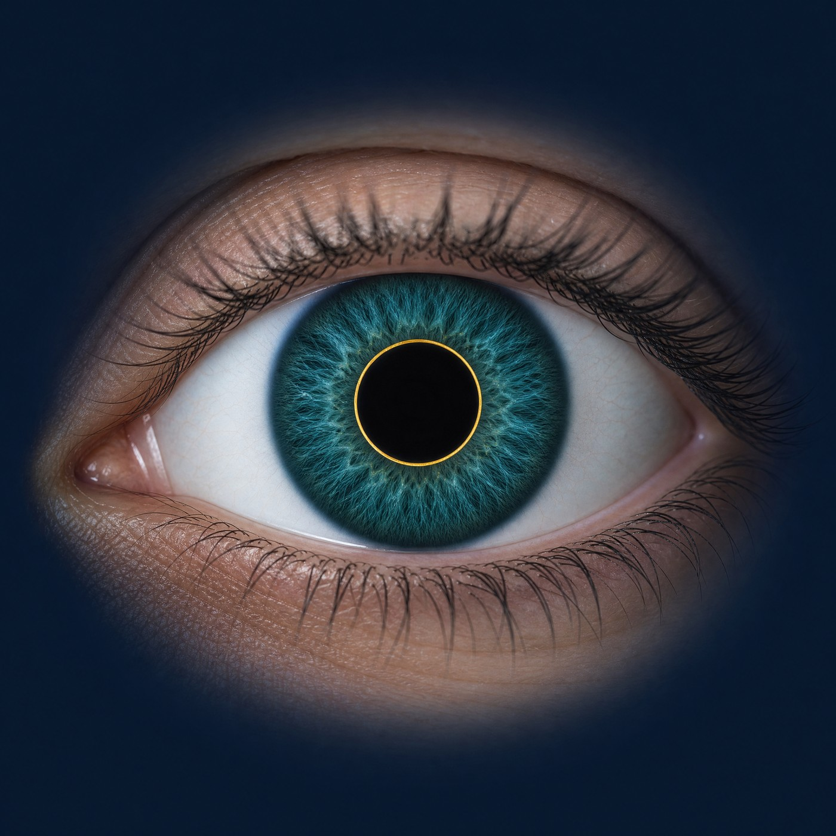
Listening Effort: Cognitive Load You Can Measure
Audiology formalizes “listening effort” — the mental resources spent decoding degraded sound (FUEL framework; Pichora-Fuller et al., 2016)
It is objectively measurable:
  Pupils dilate under cognitive load (task-evoked pupillometry)
  Dual-task performance drops; EEG signatures shift
Key finding: effort can rise even when comprehension looks unchanged — same words, higher workload
Sustained effort produces measurable listening-related fatigue (Hornsby, 2013)
© 2026 Jos Daniel · All rights reserved.

Slide 50
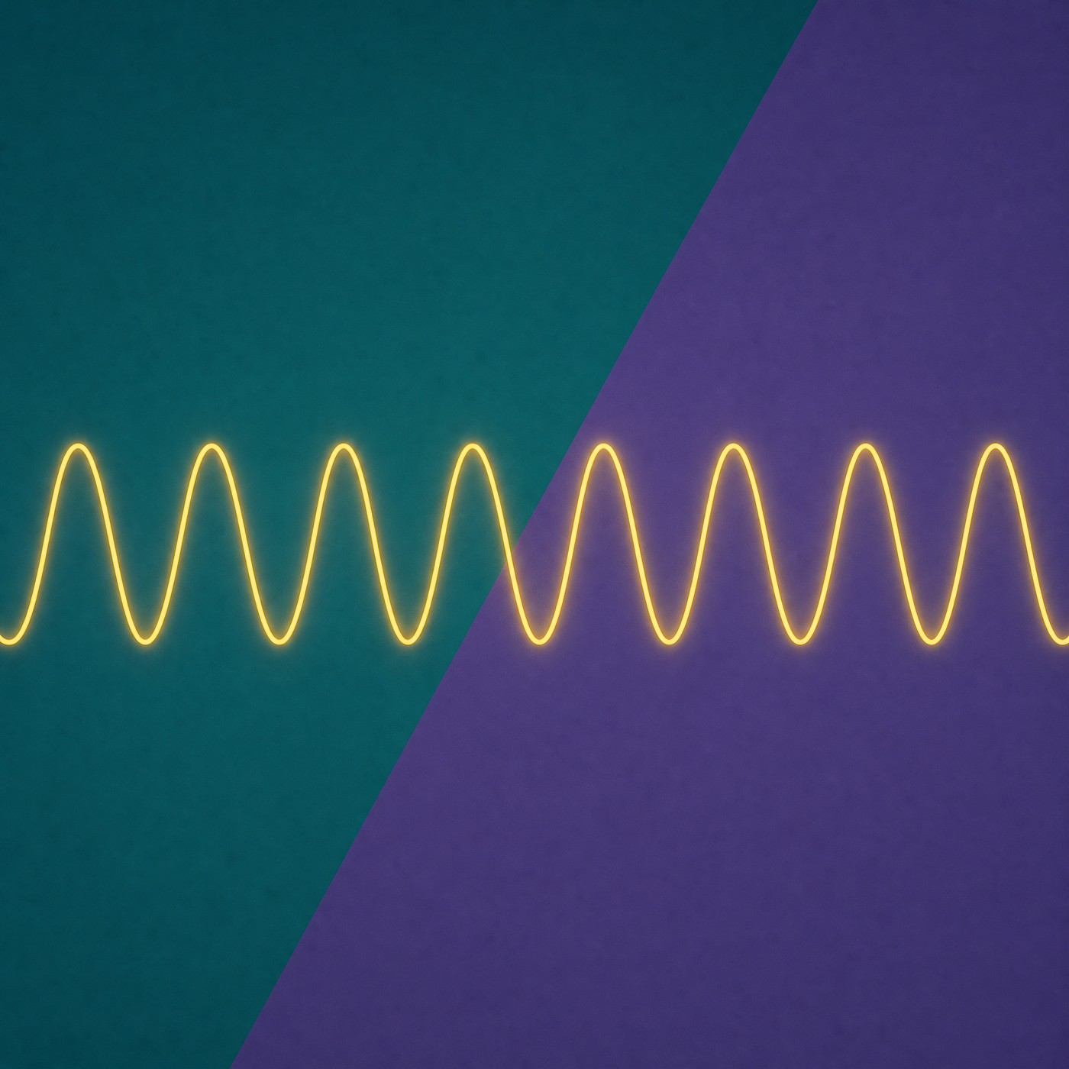
An Alpha Caveat: Context Is Everything
In relaxed wakefulness, alpha marks calm, eyes-closed rest — the story of Sections 3 and 4
But in effortful listening tasks, alpha power also rises — indexing suppression work, not bliss (Obleser et al., 2012)
Alpha also increases in drowsy disengagement
Takeaway: “more alpha = higher consciousness” oversimplifies; alpha’s meaning depends on what the brain is doing
© 2026 Jos Daniel · All rights reserved.

Slide 51
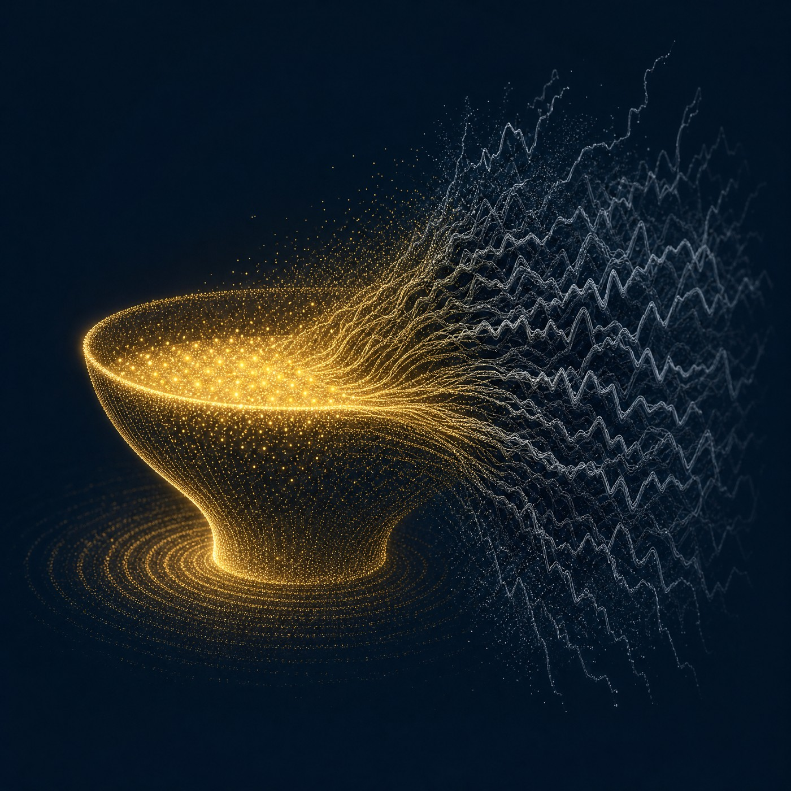
The Attention-Budget Argument
Flow requires complete, undivided attention (flow research)
Attention is a finite, capacity-limited resource (Kahneman, 1973)
Degraded auditory input recruits cognitive resources involuntarily (listening-effort research)
Therefore degraded sound competes with flow for the same budget — a reasonable inference, not yet directly tested
Honest framing: a calm sound field does not induce flow; it stops taxing the resource flow depends on
© 2026 Jos Daniel · All rights reserved.

Slide 52
SECTION 11 – FRONTIER SPECULATION: TIME CRYSTALS & THE RHYTHMIC BODY
© 2026 Jos Daniel · All rights reserved.

Slide 53

Time Crystals: The Real Physics
Proposed by Nobel laureate Frank Wilczek (2012): matter that repeats in time the way crystals repeat in space
The equilibrium version was proved impossible (Watanabe & Oshikawa, 2015)
Discrete time crystals are real: demonstrated in trapped ions and diamond spins (2017) and on Google’s quantum processor (2021)
They are fragile, driven quantum systems on the edge of isolation — laboratory physics, not (yet) biology
© 2026 Jos Daniel · All rights reserved.

Slide 54
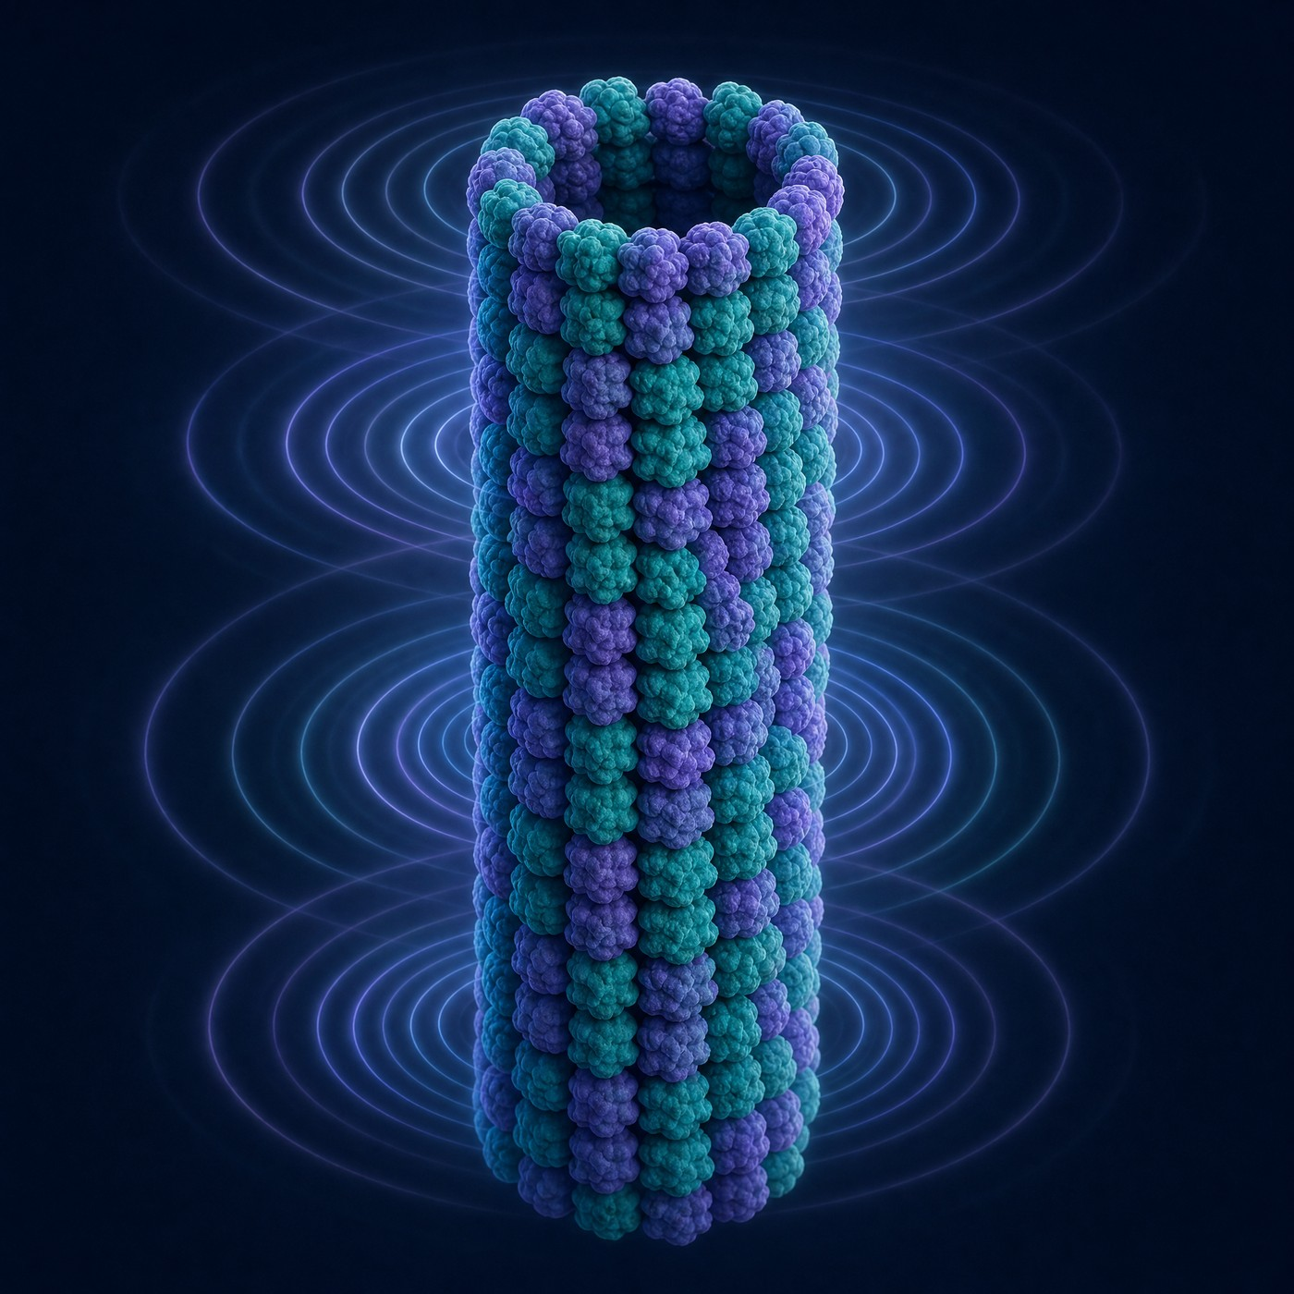
The Microtubule Conjecture (Speculative)
Hameroff, Bandyopadhyay & Lauretta (2026): microtubules may behave as “fractal time crystals” with nested resonances from hertz to terahertz
Proposed as physical support for Orch OR — the Penrose–Hameroff quantum-consciousness theory
Intriguing: anesthetics act partly on microtubule-associated targets, and biology shows a few “warm” quantum effects
Status: an open conjecture — generated by serious people, unproven, and actively contested
© 2026 Jos Daniel · All rights reserved.

Slide 55
Why Most Scientists Are Unpersuaded
Decoherence: Tegmark (2000) calculated quantum states in the warm, wet brain decay roughly ten orders of magnitude too fast to steer cognition
Replication: the key microtubule-resonance measurements come largely from one laboratory
Venue: published in a consciousness-studies journal, not a physics journal
Leading theories of consciousness (global workspace, IIT, recurrent processing) are classical — none needs quantum effects
© 2026 Jos Daniel · All rights reserved.

Slide 56

You Are, Literally, Made of Clocks (Established)
Cardiac pacemaker cells: the heartbeat is a self-starting oscillator — isolated cells keep beating in a dish
Thalamic pacemaker neurons: intrinsic 8–12 Hz oscillators behind the alpha rhythm (Section 3)
Circadian clocks run in nearly every cell (Nobel Prize, 2017)
Breathing, walking, digestion: central pattern generators make rhythm without rhythmic input
Open question: are classical oscillators the whole story? Mainstream neuroscience says yes
© 2026 Jos Daniel · All rights reserved.

Slide 57

Fascia: Real Network, Unproven Substrate
Established: fascia is richly innervated — a body-wide sensory web contributing to proprioception and interoception
Established: fascial cells sense and respond to mechanical strain (mechanotransduction)
Not established: fascia as a substrate of consciousness or a conductor of “bioenergy”
The defensible claim is smaller — and still fascinating: interoception shapes emotion and possibly the sense of self
© 2026 Jos Daniel · All rights reserved.

Slide 58
Could Sound Reach These Deep Rhythms? An Honest Audit
True: sound is mechanical vibration; loud bass can be felt in the body; noise influences autonomic arousal
No evidence: safe-level playback remodels fascia or alters thalamic pacemakers beyond ordinary hearing
No mechanism, no evidence: loudspeakers influencing putative microtubule quantum states — even proponents don’t claim it
The supported link between playback quality and inner state is classical: degraded sound raises cognitive load and taxes attention
© 2026 Jos Daniel · All rights reserved.

Slide 59
SECTION 12 – INTEGRATION & TAKEAWAYS
© 2026 Jos Daniel · All rights reserved.

Slide 60
Putting It All Together
Alpha waves are a key pattern in relaxed, aware states
Meditation often strengthens alpha and theta activity as the mind settles
Samadhi emphasises deep, sustained absorption
Satori emphasises sudden awakening
Neurofeedback offers tools to explore and train brain states, but is not a guarantee of spiritual insight
Sound: degraded audio taxes the attention flow needs
Frontiers: time crystals & fascia stay labeled speculative
© 2026 Jos Daniel · All rights reserved.

Slide 61
Science and Spirituality in Dialogue
Neuroscience can:
  Measure patterns
  Test hypotheses
  Clarify mechanisms
Traditions can:
  Describe inner landscapes
  Offer ethical and practical frameworks
Together, they invite a richer understanding of consciousness and human potential
© 2026 Jos Daniel · All rights reserved.

Slide 62
Closing Thought
Brainwaves are the language of the brain
Samadhi and Satori are languages of experience
When we listen to both carefully, we gain a more complete picture of what it means to be fully awake and fully alive
© 2026 Jos Daniel · All rights reserved.

